Slide 1
AWARE Today. ALIVE Tomorrow.
Vehicle Data Translator [VDT]
Using vehicles to diagnose the weather
Sheldon Drobot
drobot@ucar.edu
Michael Chapman, Elena Schuler, Brice Lambi, Gerry Wiener, William Mahoney, NCAR
Paul A. Pisano, FHWA
Ben McKeever, RITA
All slides Copyright 2010 Sheldon Drobot/NCAR

Slide 2
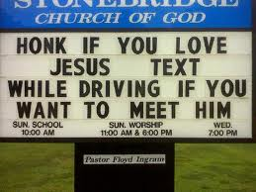
Objective
Outline NCAR research through the lens of a potential I-80 Coalition project

Slide 3
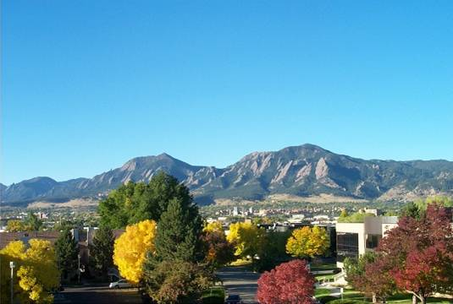

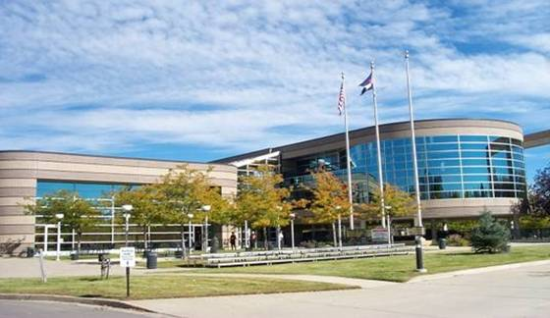

Foothills Lab
Campus
Center Green
Campus
Aviation Facility
Mesa Lab

Slide 4
Research Applications Laboratory
RAL
  One of five laboratories of NCAR
  About 200 people, approximately half are atmospheric scientists, and half are software engineers
Mission
  Transfer knowledge and technology to US government agencies, the private sector, and foreign governments

Slide 5
The promise of mobile observations
Technology
Consumer
Interest
DOT IntelliDriveSM
Initiative
VDT

Slide 6
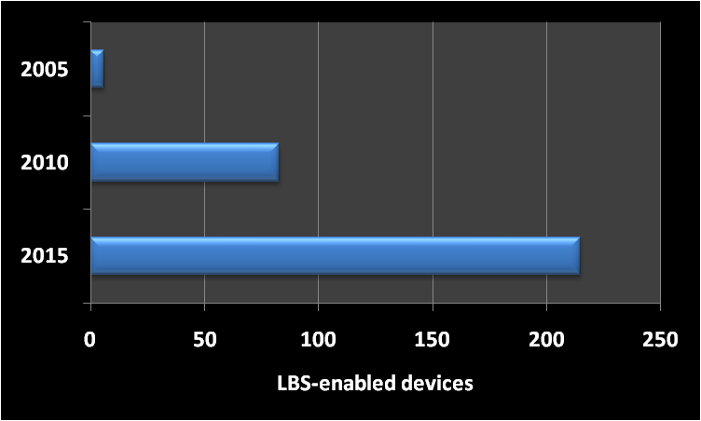
Transportation market trends
2016, connectivity will be a “critical buying consideration” on par with fuel efficiency, safety, etc.
2020, 30-90 million connected vehicles.

Slide 7
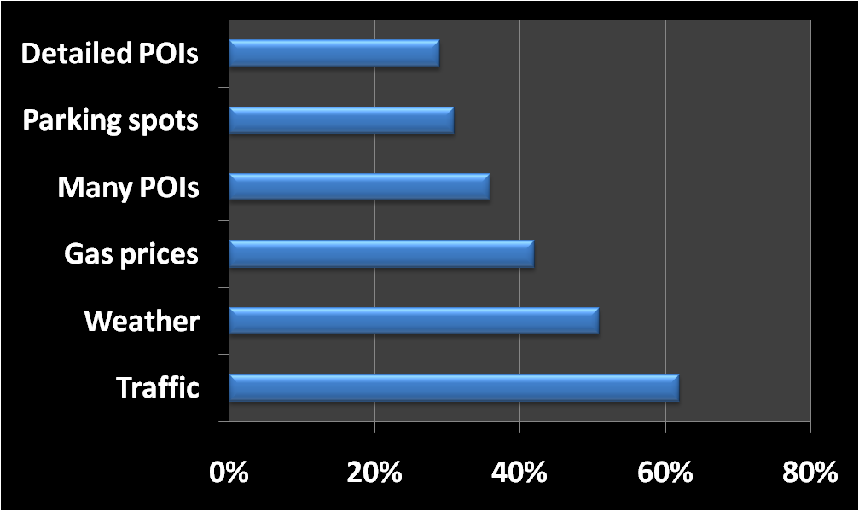
Consumer interest in transportation information
Data from JPO survey

Slide 8

The IntelliDriveSM initiative
IntelliDriveSM is a suite of technologies and applications that use wireless communications
IntelliDriveSM applications provide connectivity:
  with and among vehicles
  between vehicles and the roadway infrastructure
  among vehicles, infrastructure, and wireless devices (consumer electronics, such as cell phones and PDAs) that are carried by drivers, pedestrians, and bicyclists
http://www.intellidriveusa.org

Slide 9
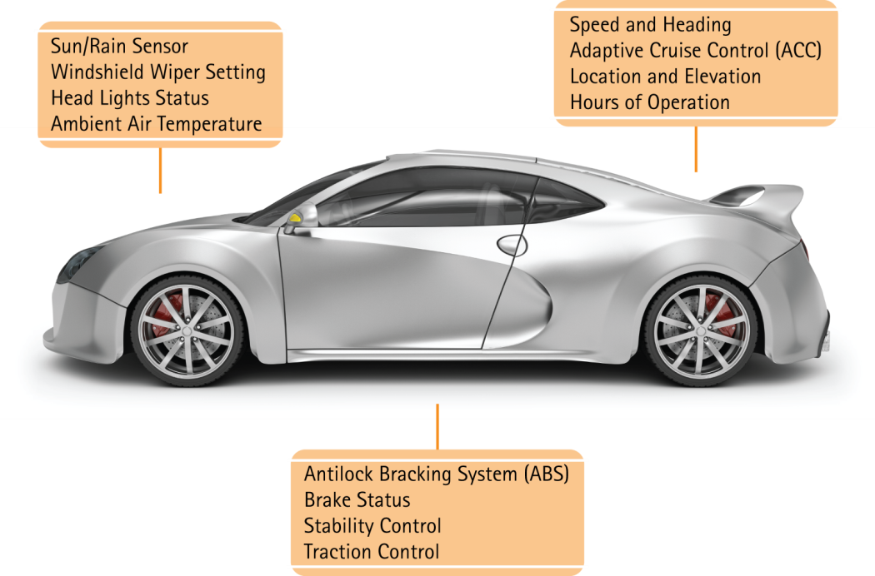
Vehicle data in IntelliDriveSM

Slide 10
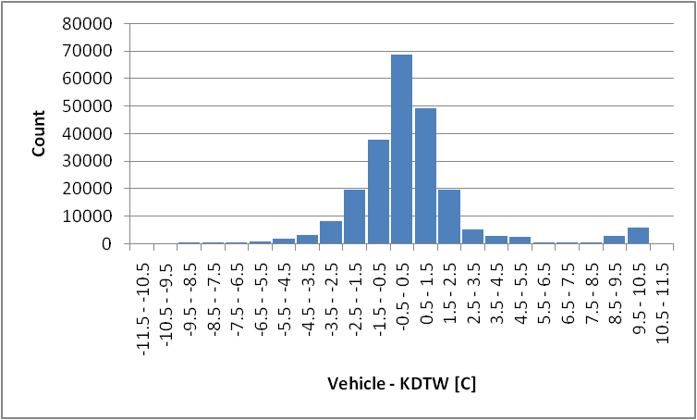
Temperature accuracy (DTE09)

Slide 11
Vehicle Data Translator (VDT) Concept
Radar
Satellite
Models
Point Obs
Parsed Mobile Data
QCh Mobile Data
Segment Stats
Segment Assessments
Gridded Assessments
Mobile Obs

Slide 12
Mixed
What is the radar reflectivity?
What is the wiper state?
What is the wiper state?
What is the air temperature?
No precip
Light-moderate snowfall
Heavy snowfall
What is the air temperature?
Is the speed ratio between 0.2 and 0.5?
Is the speed ratio between 0.2 and 0.5?
Light to moderate rainfall
Light to moderate freezing rain/mixed precip
Light to moderate freezing rain/mixed precip
Light-moderate rainfall
Heavy freezing rain/mixed precip
Heavy rainfall
Heavy rainfall
Heavy freezing rain/mixed precip

Slide 13
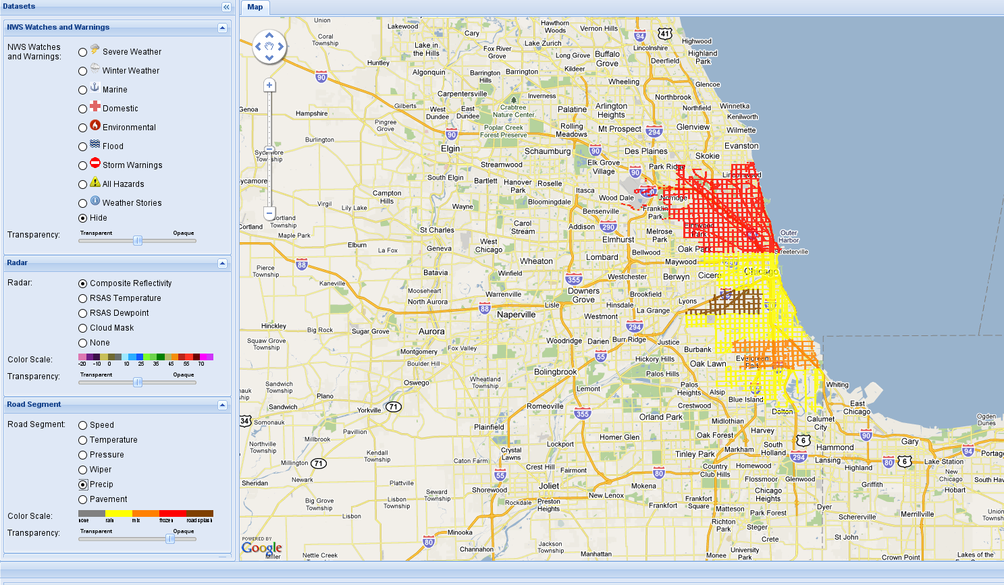
Display

Slide 14
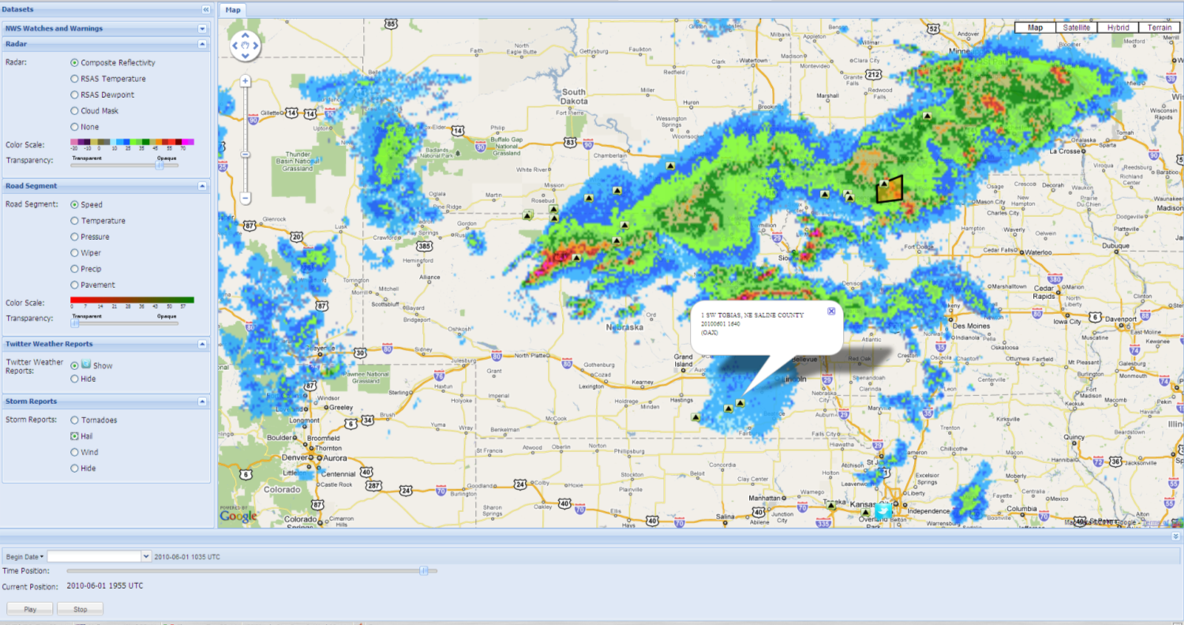
VDT display

Slide 15
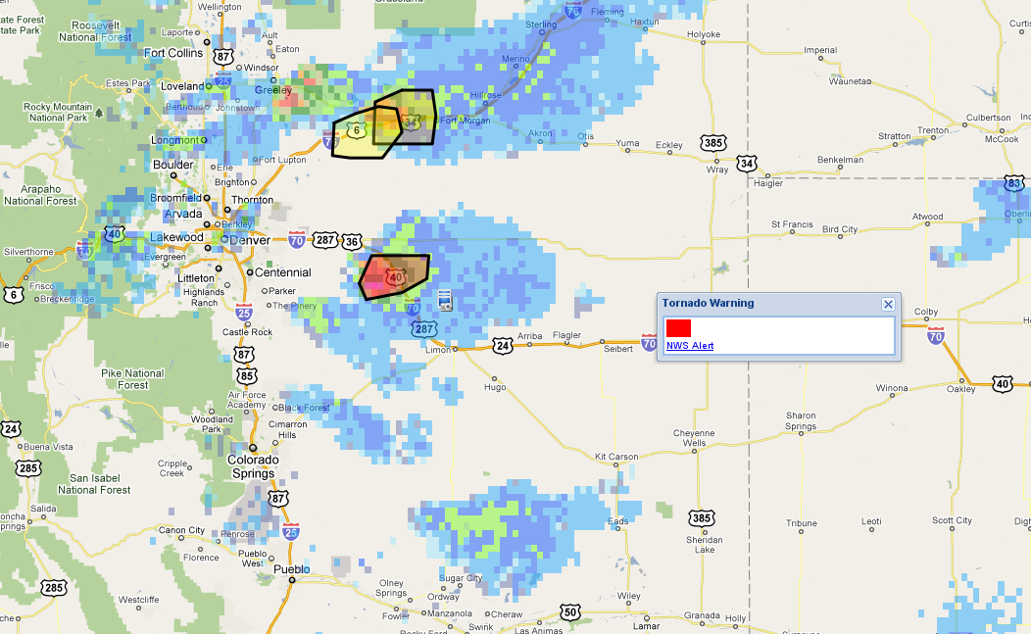
NWS Polygon Warnings

Slide 16
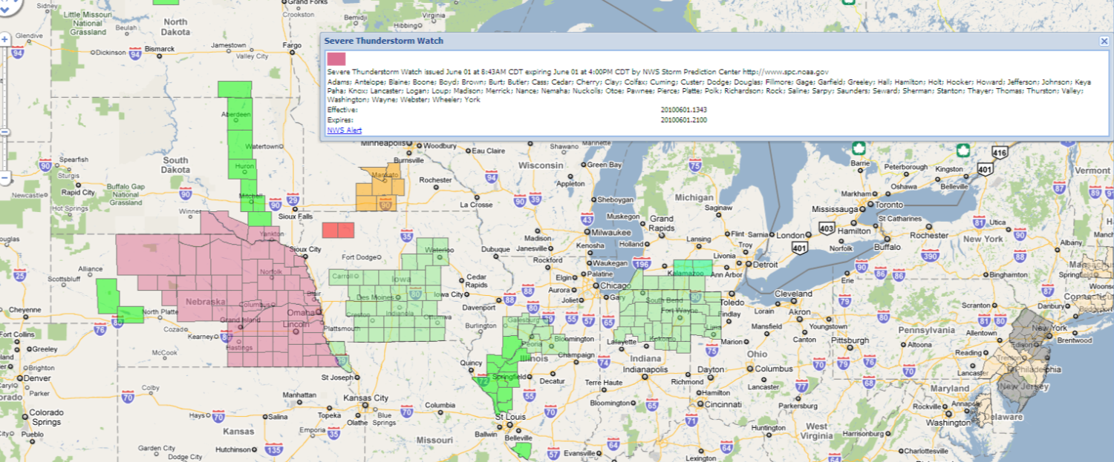
NWS watch / warning information

Slide 17
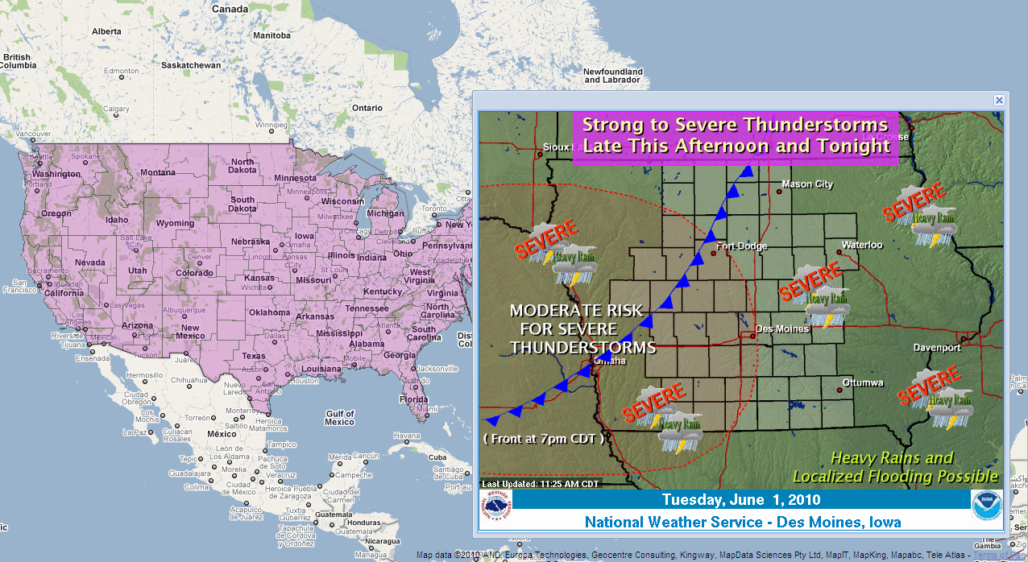
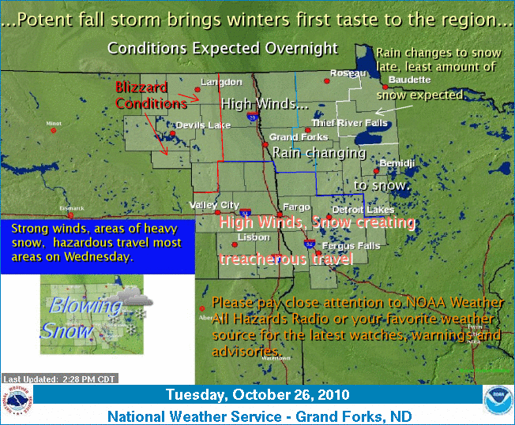
NWS Story of the Day

Slide 18
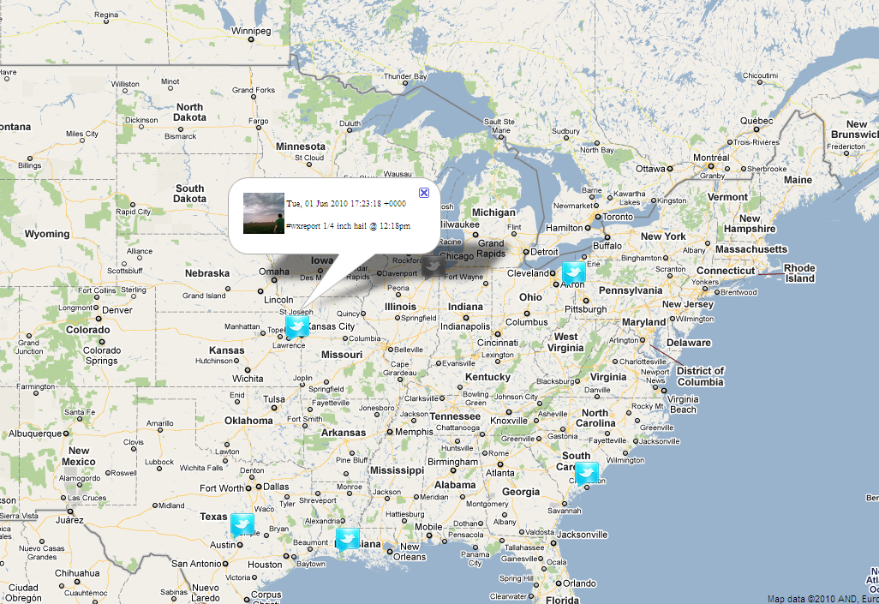
Twitter Feeds

Slide 19
What else could we add?
Traffic information?
CMS messages?
Audio alerts?
What do you want/need?

Slide 20
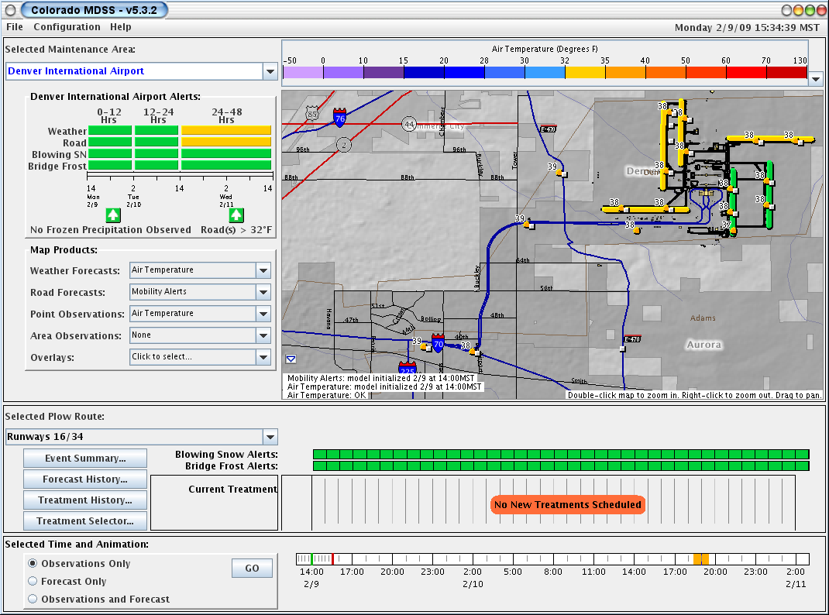
What about forecasts?

Slide 21
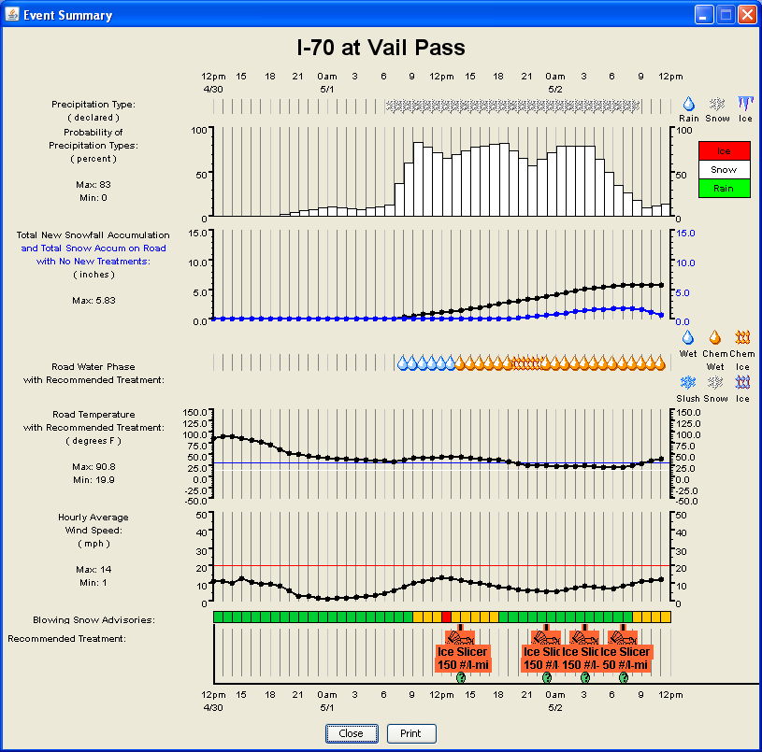
Event Summaries

Slide 22

it's not the end, it's merely the beginning
“Dream no small dreams for they have no power to move the hearts of men.”
--Johann Wolfgang von Goethe

